Slide 1
PL/SQL:
Control Structures and Embedded SQL

Slide 2
You will learn about various programming control structures in PL/SQL.
Different decision-making statements based on various options.
Looping statements are introduced to perform a set of statements repetitively.
SQL statements are embedded within a PL/SQL block to interact with the Oracle server.

Slide 3
CONTROL STRUCTURES
In a procedural language like PL/SQL, there are three basic programming control structures:
  In a sequential structure, a series of instructions are performed from the beginning to the end in a linear order.
    None of the instructions is skipped, and none of the instructions is repeated.
  The selection structure is also known as a decision structure or an IF-structure.
    It involves conditions with a TRUE or FALSE outcome.
    Based on the outcome, one of the options is performed and the other option is skipped.
    Selection statements are also available for multiple options.
  In a looping structure, a series of instructions are performed repeatedly.
    There are different looping statements appropriate for a variety of situations.
    A programmer has to write a loop correctly to make it perform a specific number of times.

Slide 4
SELECTION STRUCTURE
There are three selection or conditional statements in PL/SQL.
  Relational operators,
  Logical operators,
  Special operators to create boolean expressions or conditions.
PL/SQL has five conditional or selection statements available for decision making:
  IF…THEN…END IF
  IF…THEN…ELSE…END IF
  IF…THEN…ELSIF…END IF
  CASE…END CASE

Slide 5
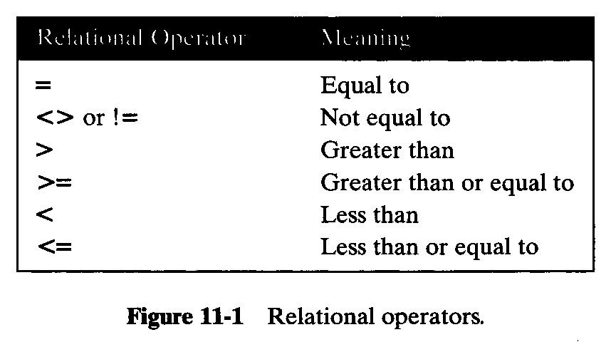
SELECTION STRUCTURE
Relational Operators:

Slide 6
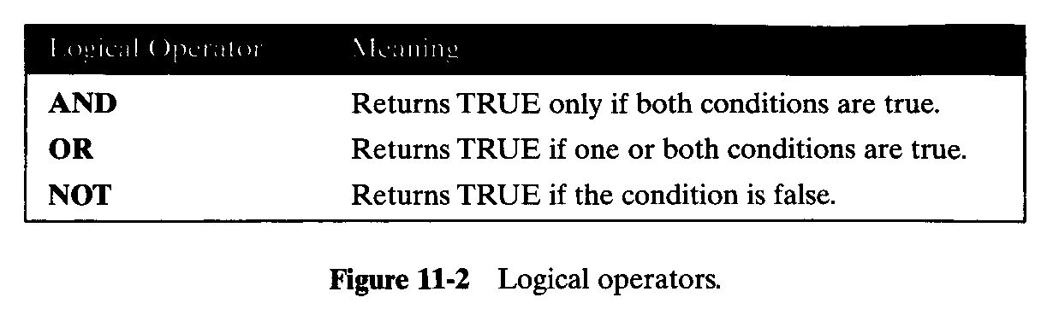
SELECTION STRUCTURE
Logical Operators:

Slide 7
SELECTION STRUCTURE
IF…THEN…END IF
  This statement is also known as a simple IF statement.
  The simple IF statement performs action statements if the result of the condition is TRUE.
  If the condition is FALSE, there is no action to perform and the program continues with the next statement in the block.
        IF condition(s) THEN
        Action statements
        END IF;
  You must have noticed the indentation in program code.
  All program statements can start in the first column.
  In fact, you can write more than one statement on one line with the appropriate punctuation mark (;) separating them.

Slide 8
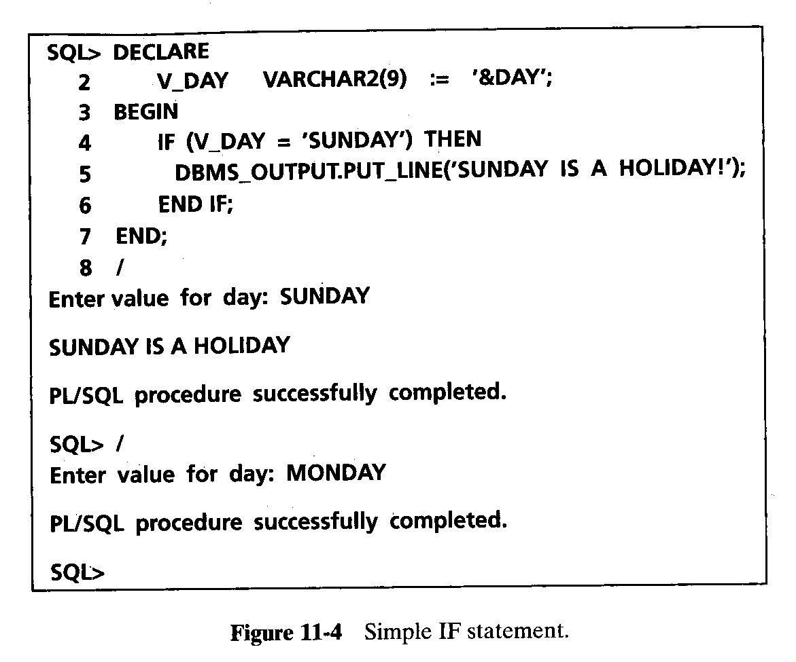
SELECTION STRUCTURE

Slide 9
SELECTION STRUCTURE
IF…THEN…ELSE...END IF
  This statement is an extension of the simple IF statement.
  This statement provides action statements for the TRUE outcome as well as the FALSE outcome.
        IF condition(s) THEN
        Action statements 1
        ELSE
        Action statements 2
        END IF
  If the condition’s outcome is TRUE, action statements 1 are performed.
  If the outcome is FALSE, action statements 2 are performed.
  One set of statements is skipped in any case.
IF…THEN…ELSE...END IF
  This statement is an extension of the simple IF statement.
  This statement provides action statements for the TRUE outcome as well as the FALSE outcome.
        IF condition(s) THEN
        Action statements 1
        ELSE
        Action statements 2
        END IF
  If the condition’s outcome is TRUE, action statements 1 are performed.
  If the outcome is FALSE, action statements 2 are performed.
  One set of statements is skipped in any case.
IF…THEN…ELSIF…END IF. This statement is an extension to the previous statement. When you have many alternatives/options, you can use previously explained statements, but the ELSIF alternative is more efficient than the other two. The DECODE function discussed in SQL is not allowed in PL/SQL, and IF…THEN…ELSIF…END IF statement is not allowed in SQL. The general syntax is
IF condition(s)1 THEN
Action statements 1
ELSIF condition(s)2 THEN
Action statements 2
. . .
ELSIF condition(s)N THEN
Action statement N
[ELSE
Else Action statements]
END IF

Slide 10
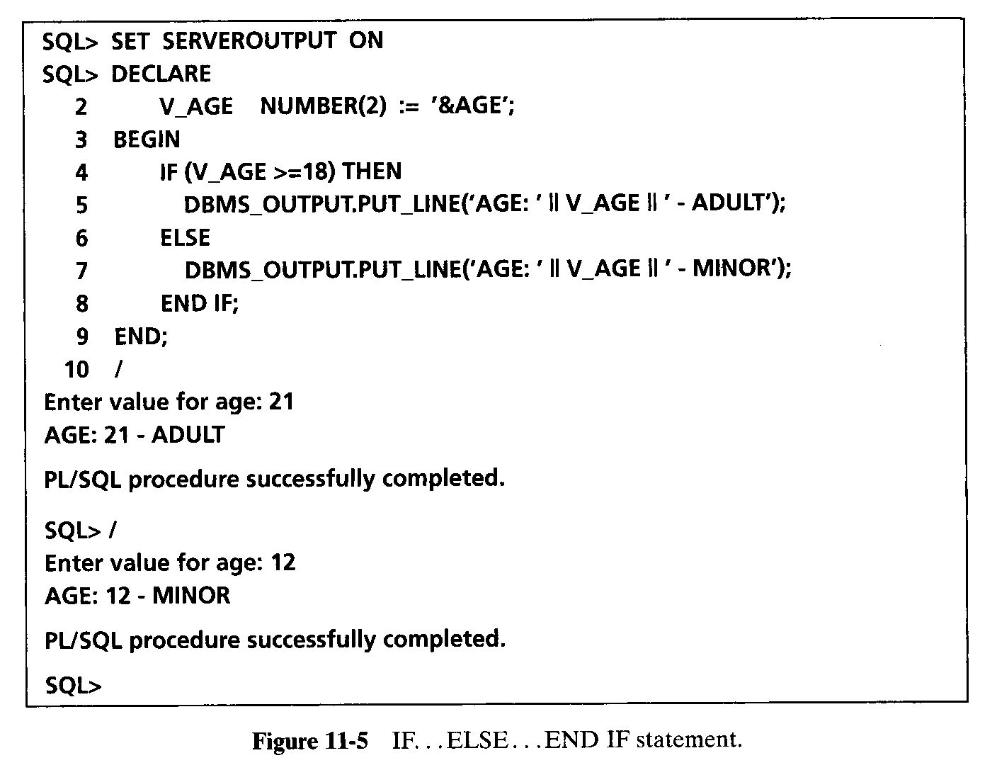
SELECTION STRUCTURE

Slide 11
SELECTION STRUCTURE
IF…THEN…ELSIF…END IF
  This statement is an extension to the previous statement.
  When you have many alternatives/options, you can use previously explained statements, but the ELSIF alternative is more efficient than the other two.
  The DECODE function discussed in SQL is not allowed in PL/SQL, and IF…THEN…ELSIF…END IF statement is not allowed in SQL.
        IF condition(s)1 THEN
        Action statements 1
        ELSIF condition(s)2 THEN
        Action statements 2
        . . .
        ELSIF condition(s)N THEN
        Action statement N
        [ELSE
        Else Action statements]
        END IF

Slide 12
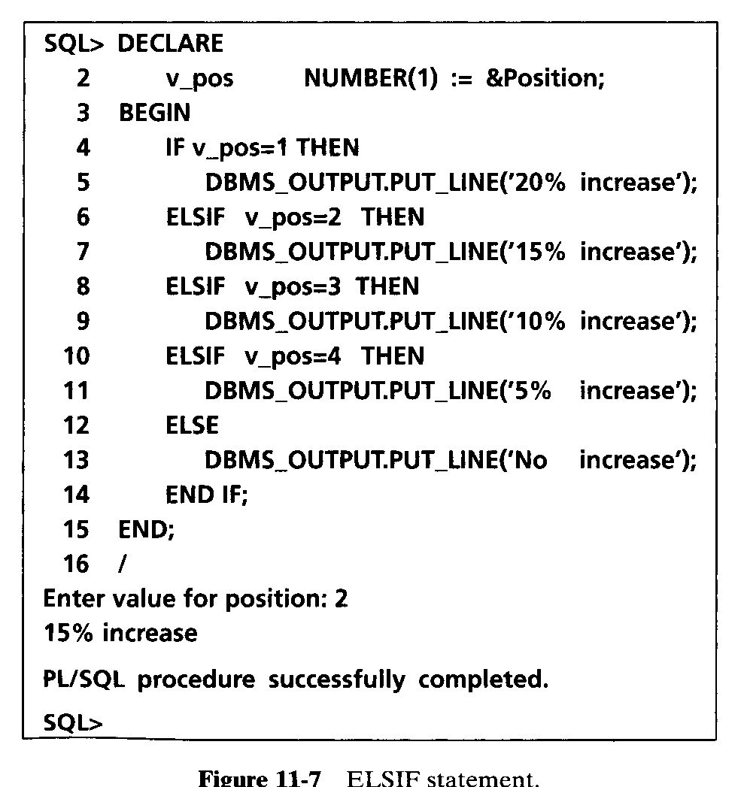
SELECTION STRUCTURE

Slide 13
SELECTION STRUCTURE
CASE statement
  The CASE statement is an alternative to the IF…THEN…ELSIF…END IF statement.
  The statement begins with keyword CASE and ends with keywords END CASE.
  The body of CASE contains WHEN clauses with values or conditions, and action statements.
  When a WHEN clause’s value/condition evaluates to TRUE, its action statements are executed.
CASE [variable_name]
WHEN value1|condition1 THEN action_statement1;
WHEN value2\condition2 THEN action_statement2;
…
WHEN valueN|conditionN THEN action_statementN;
ELSE action_statement;
END CASE;

Slide 14
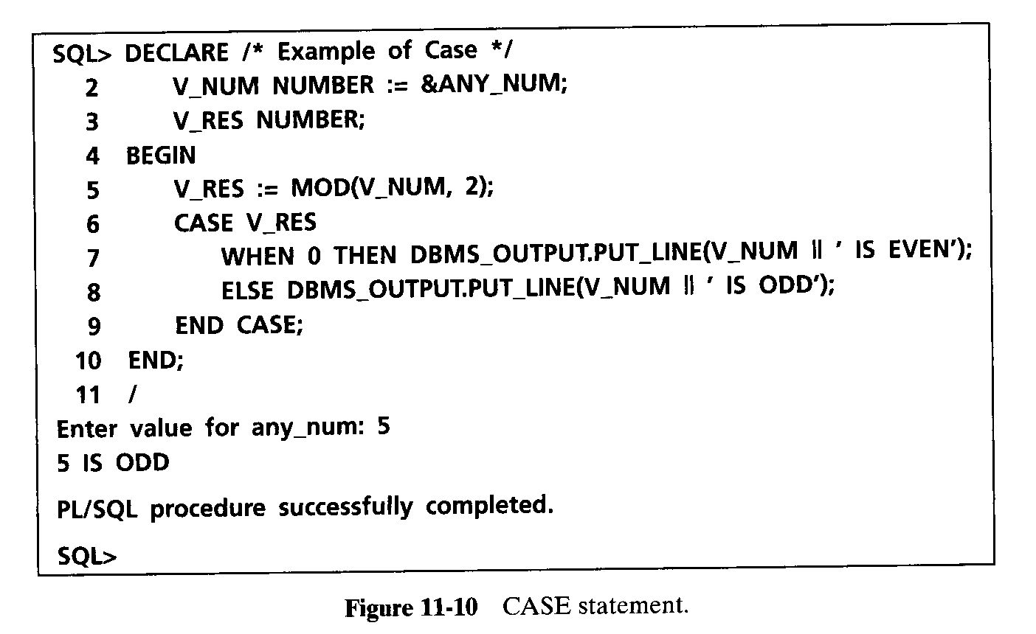
SELECTION STRUCTURE

Slide 15
SELECTION STRUCTURE
Nested IF statement
  The nested IF statement contains an IF statement within another IF statement.
  If the condition in the outer IF statement is TRUE, then the inner IF statement is performed.
  Any IF statement with a compound condition can be written as a nested IF statement.

Slide 16
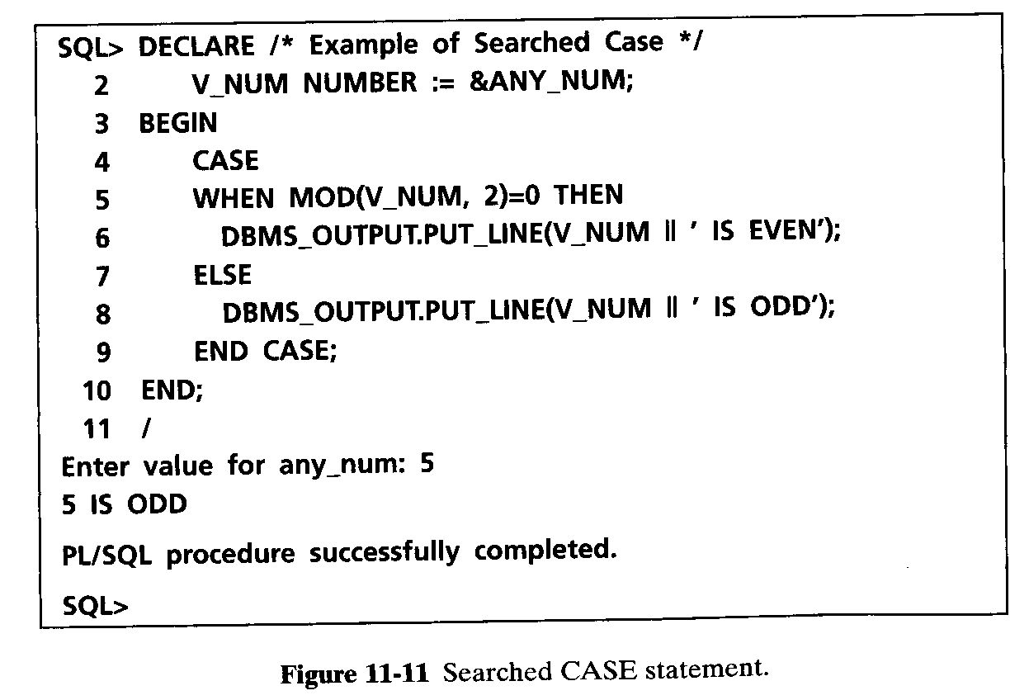
SELECTION STRUCTURE

Slide 17
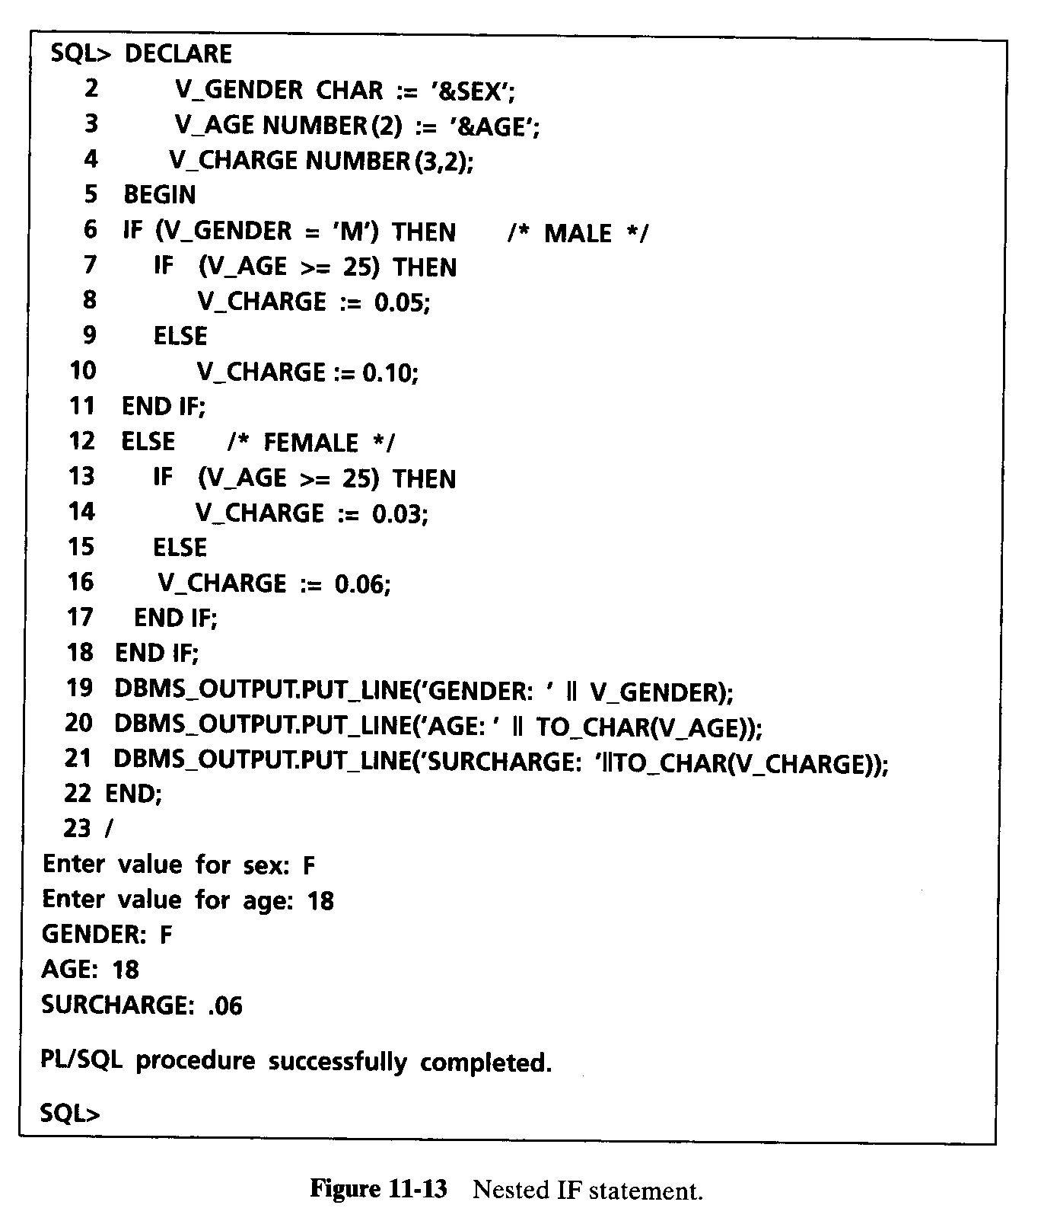
SELECTION STRUCTURE

Slide 18
LOOPING STRUCTURE
Looping means iterations.
A loop repeats a statement or a series of statements a specific number of times as defined by the programmer.
You would use a loop to repeat a series of statements many times rather than typing the same statements many times.
There are three types of looping statements available in PL/SQL:
  Basic loop
  WHILE loop
  FOR loop
Each loop has different syntax, and their working is a little different from each other.

Slide 19
LOOPING STRUCTURE
Basic loop
  A basic loop is a loop that is performed repeatedly.
  When the bottom of the loop is reached, control shifts back to the top of the loop.
  The only way to terminate a basic loop is by adding an EXIT statement inside the loop.
        LOOP
        Looping statement1;
        Looping statement2;
        . . .
        Looping statementN;
        EXIT [WHEN condition];
        END LOOP;
  The condition is not checked at the top of the loop, but it is checked inside the body of the loop.
  The basic loop is performed at least once as the condition is tested after entering body of the loop.

Slide 20
LOOPING STRUCTURE
Basic loop (cont.)
  There are three necessary statements in a counter-controlled loop.
  The counter must be initialized, the value of the counter must change within the loop (increment or decrement), and a proper condition must exist in the loop.
  If value of the counter is not changed inside the loop, it will result in an infinite loop.
  The initial value, the increment/decrement, and the condition control the total number of loop executions.

Slide 21
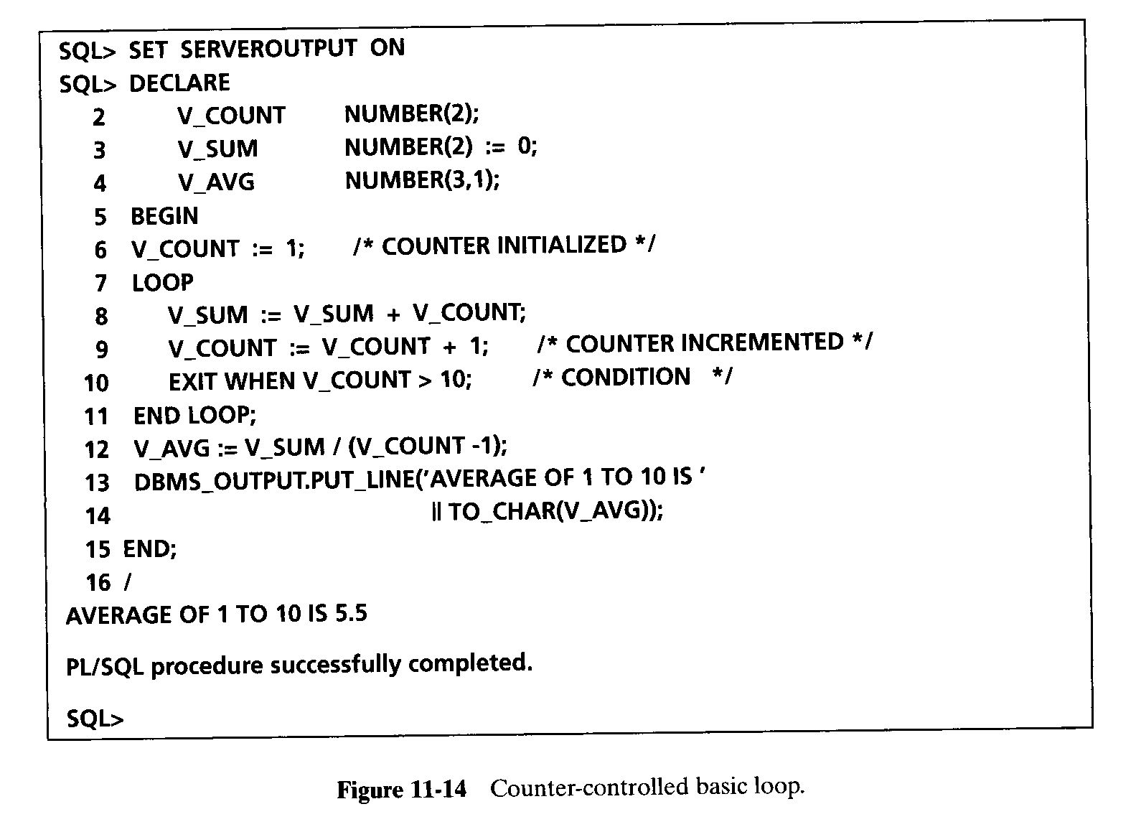
LOOPING STRUCTURE

Slide 22
LOOPING STRUCTURE
WHILE loop
  The WHILE loop is an alternative to the basic loop.
  The WHILE loop is performed as long as the condition is true.
  It terminates when the condition becomes false.
  If the condition is false at the beginning of the loop, the loop is not performed at all.
  The WHILE loop does not need an EXIT statement to terminate.
        WHILE condition LOOP
        Looping statement 1;
        Looping statement 2;
        . . .
        Looping statement n;
        END LOOP;

Slide 23
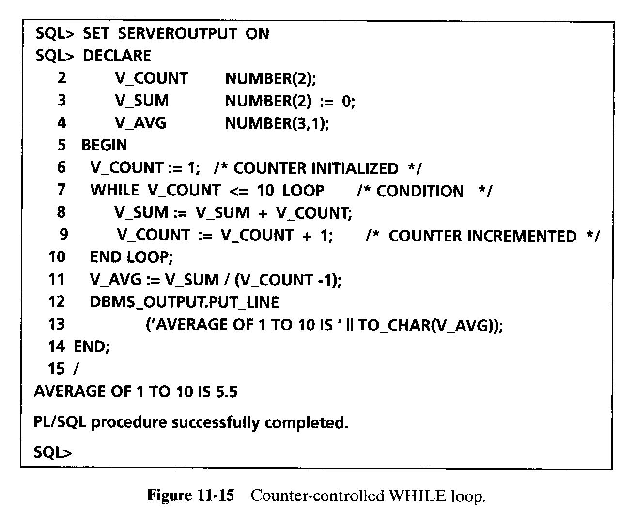
LOOPING STRUCTURE

Slide 24
LOOPING STRUCTURE
FOR loop
  The FOR loop is the simplest loop you can write.
  Unlike the other two loops, you do not have to initialize, test, and increment/decrement the loop control variable separately. You do it in the loop’s header.
  There is no need to use an EXIT statement, and the counter need not be declared.
  The counter used in the loop is implicitly declared as an integer, and it is destroyed on the loop’s termination.
  Counter may not be used within the loop body in an assignment statement as a target variable.
        FOR counter IN [REVERSE] lower..upper LOOP
        Looping statement1
        Looping statement2
        . . .
        Looping statementN
        END LOOP;

Slide 25
LOOPING STRUCTURE
FOR loop (cont.)‏
  The counter varies from the lower value to the upper value, incrementing by 1 with every loop execution.
  The loop can be used with the counter starting at a higher value and decrementing by 1 with every loop execution.
  The keyword REVERSE is used for varying the counter in the reverse order, or from higher to lower value.
  One important point about loop control variable is that it is declared, incremented/decremented and destroyed implicitly, but its value cannot be changed explicitly within the FOR loop’s body.
  It cannot be a target variable in an assignment statement.

Slide 26
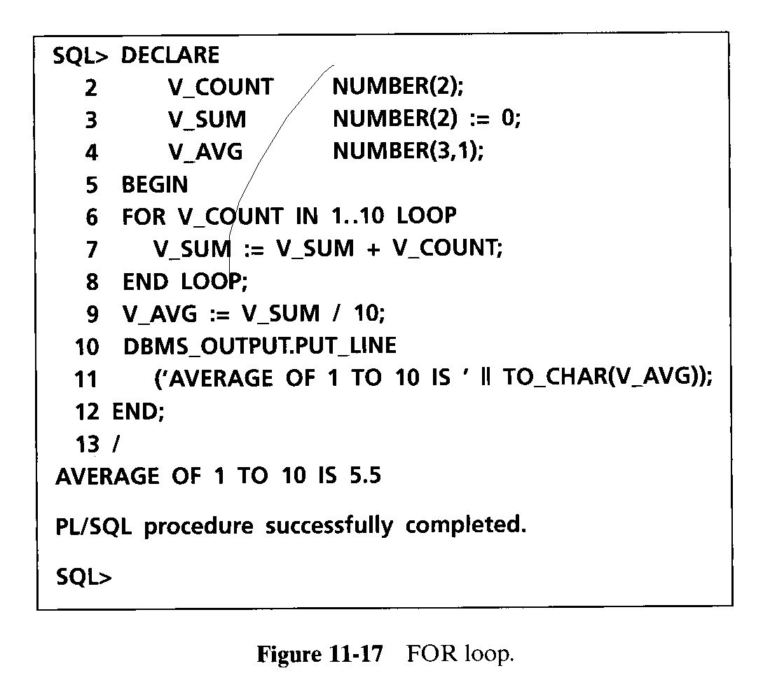
LOOPING STRUCTURE

Slide 27
LOOPING STRUCTURE
Nested loops
  You can use a loop within another loop.
  The nesting of loops can be to many levels.
  When the inner loop ends, it does not automatically end the outer loop enclosing it.
  You can end an outer loop from within the inner loop by labeling each loop and then using the EXIT statement.
  The EXIT WHEN exits the current loop, but EXIT out_loop WHEN exits the outer loop also.
  The loop labels use the same naming rules used for identifiers.
  The loops are labeled before the keyword LOOP on the same line or on a separate line.
  The loop label is enclosed within two pairs of angle brackets (<< and >>).

Slide 28
LOOPING STRUCTURE
<<out_loop>>
LOOP
. . .
EXIT WHEN condition;
<<in_loop>>
LOOP
. . .
EXIT out_loop WHEN condition; /* exits out_loop */
EXIT WHEN condition; /*exits in_loops */
. . .
END LOOP in_loop; /* label optional here */
. . .
END LOOP out_loop; /*label optional here */

Slide 29
NESTED BLOCKS
PL/SQL block may contain another PL/SQL block, or in other words PL/SQL blocks can be nested.
The execution starts with the outer block and continues with the inner block.
The variables declared in the outer block are global to the inner block, and they are accessible in the inner block.
The variables declared in the inner block are not accessible in the outer block.
DECLARE /* Outer block starts here.*/
Var1 NUMBER; /* known to outer and inner*/
BEGIN
. . . /* can use Var1 here */
  DECLARE /*Inner block starts here.*/
Var2 NUMBER; /* known to inner block */
  BEGIN
. . . /* can use Var1 and Var2 here */
  END; /* Inner block ends here.*/
. . . /* can use Var1 here */
END; /* Outer block ends here.*/

Slide 30
Substitution Variables
PLSQL is not a stand alone programming language
It exists only as a tool with in the Oracle programming environment.
It does not have a capabilities to accept input from the user.
SQL*Plus allows a PL/SQL block to receive input information with the help of substitution variables.
Substitution variables cannot be used to output values, because no memory is allocated for them.
SQL*Plus substitutes avariable before the PL/SQL block is sent to the database.
Substitution variables usually prefixed by the ( &) or double ampersand(&&) characters

Slide 31
EXAMPLE
DECLARE
v_student_id NUMBER := &sv_student_id;
v_first_name VARCHAR2(35);
v_last_name VARCHAR2(35);
BEGIN
SELECT first_name, last_name
INTO v_first_name, v_last_name
FROM student
WHERE student_id = v_student_id;
DBMS_OUTPUT.PUT_LINE
('Student name: '||v_first_name||' '||v_last_name);
EXCEPTION
WHEN NO_DATA_FOUND THEN
DBMS_OUTPUT.PUT_LINE('There is no such student');
END;

Slide 32
SQL IN PL/SQL
The PL/SQL statements have control structures for calculations, decision making, and iterations.
You need to use SQL to interface with the Oracle database.
When changes are necessary in the database, SQL can be used to retrieve and change information.
PL/SQL supports all the Data Manipulation Language (DML) statements such as INSERT, UPDATE, and DELETE.
It also supports the Transaction Control Language statements ROLLBACK, COMMIT, and SAVEPOINT.
You can retrieve data using the data retrieval statement SELECT.
A row of data can be used to assign values to variables.
More than one row can be retrieved and processed using cursors.

Slide 33
SQL IN PL/SQL
PL/SQL statements can use single-row functions, but group functions are not available for PL/SQL statements.
SQL statements in PL/SQL block can still utilize those group functions.
PL/SQL does not support Data Definition Language (DDL) statements such as CREATE, ALTER, and DROP.
The Data Control Language (DCL) statements GRANT and REVOKE are not available in PL/SQL either.

Slide 34
SELECT Statement in PL/SQL
The SELECT statement retrieves data from Oracle tables.
The syntax of SELECT is different in PL/SQL because it is used to retrieve values from a row into a list of variables or into a PL/SQL record.
SELECT ColumnNames INTO VariableNames / RecordName
FROM TableName WHERE condition;
  where ColumnNames must contain at least one column and may include arithmetic or string expressions, single-row functions, and group functions.
  VariableNames contains a list of local or host variables to hold values retrieved by the SELECT clause.
  The variables are either declared at SQL*Plus prompt, or declared locally under the DECLARE section.
  RecordName is a PL/SQL record.

Slide 35
SELECT Statement in PL/SQL
  All the features of SELECT in SQL are available with an added mandatory INTO clause.
  The INTO clause must contain one variable for each value retrieved from the table.
  The order and data type of columns and variables must correspond.
  The SELECT…INTO statement must return one and only one row.
  If no rows are returned, the standard exception (error condition) NO_DATA_FOUND occurs.
  If more than one row is retrieved, the TOO_MANY_ROWS exception occurs.
  The SQL statement in PL/SQL ends with a semicolon.
  The INTO clause is mandatory in SELECT statement, when used in a PL/SQL block.

Slide 36
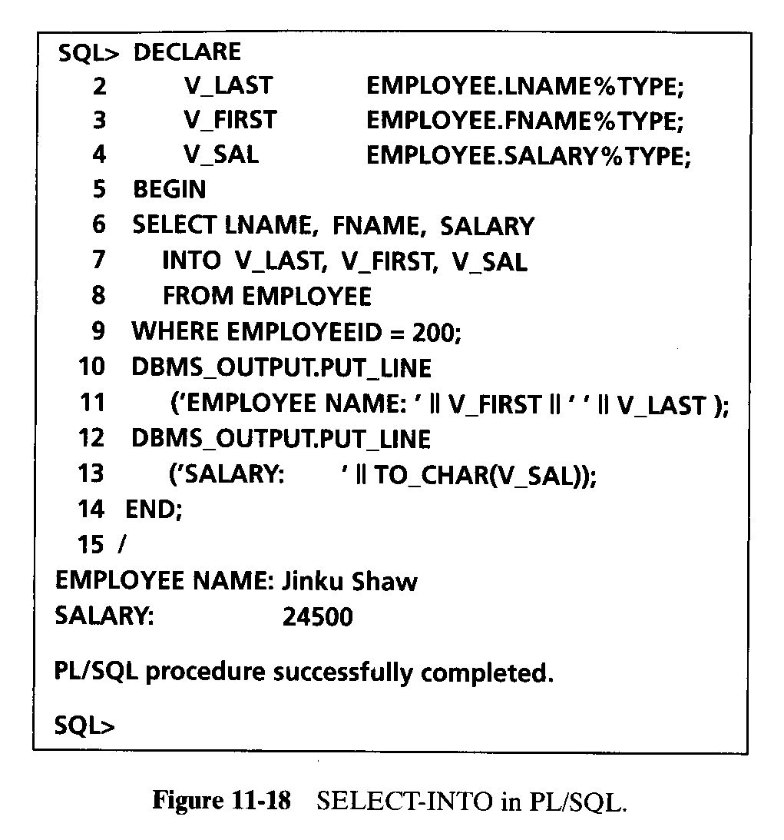
SELECT Statement in PL/SQL

Slide 37
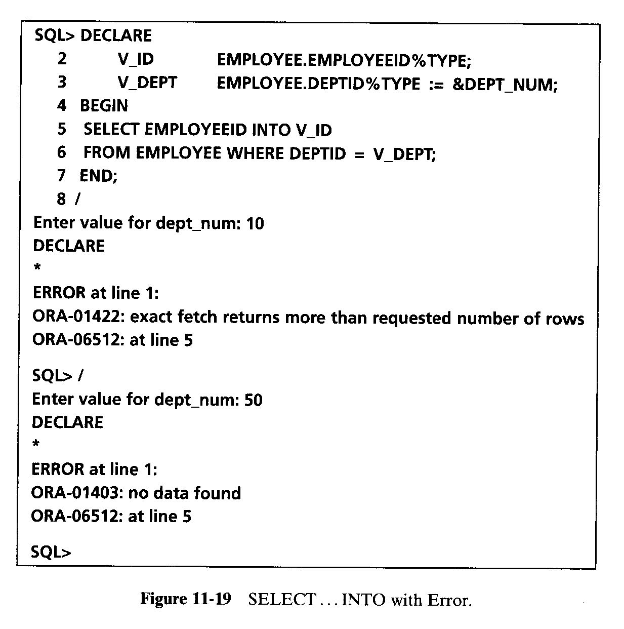
SELECT Statement in PL/SQL

Slide 38
DATA MANIPULATION IN PL/SQL
You can use all DML statements in PL/SQL with the same syntax you used in SQL.
The three DML statements to manipulate data are
  INSERT Statement
    The INSERT statement to add a new row in a table.
  DELETE Statement
    The DELETE statement to remove a row or rows.
  UPDATE Statement
    The UPDATE statement to change values in a row or rows.

Slide 39
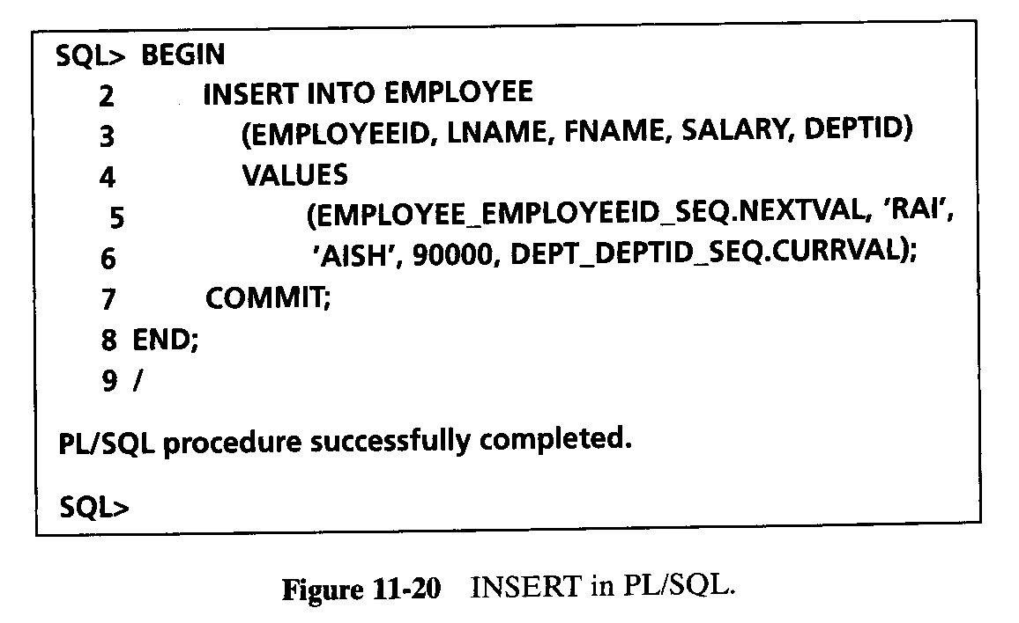
DATA MANIPULATION IN PL/SQL
ORACLE sequence is an Oracle database object that can be used to generate unique numbers.
Use sequences to automatically generate primary key values
Once the sequence has been created, you can access its values in SQL statements with these pseudo columns
CURRVAL :returns the current value of the sequence
NEXTVAL: increments the sequence and returns the new value

Slide 40
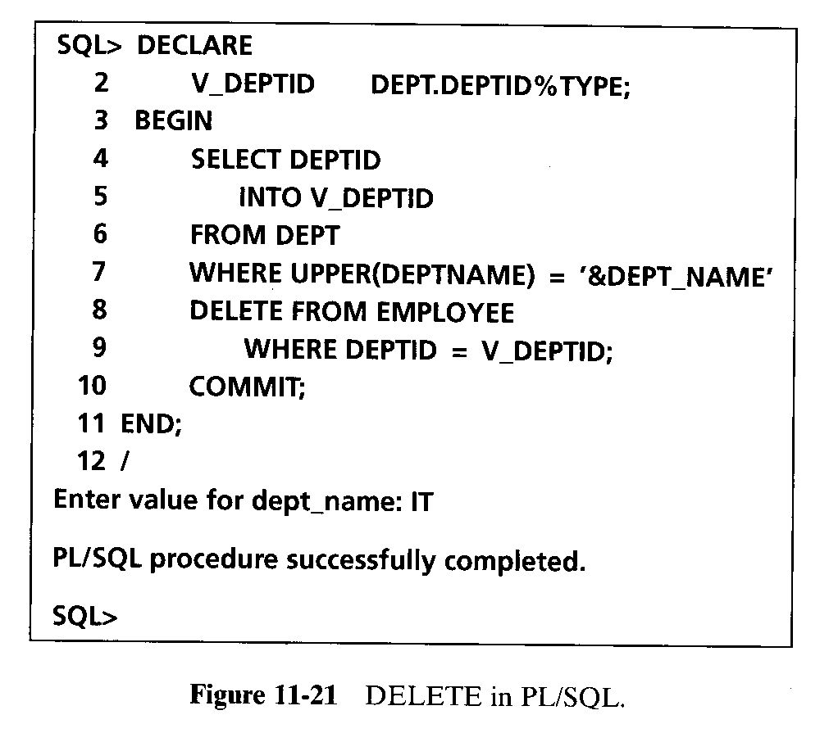
DATA MANIPULATION IN PL/SQL

Slide 41
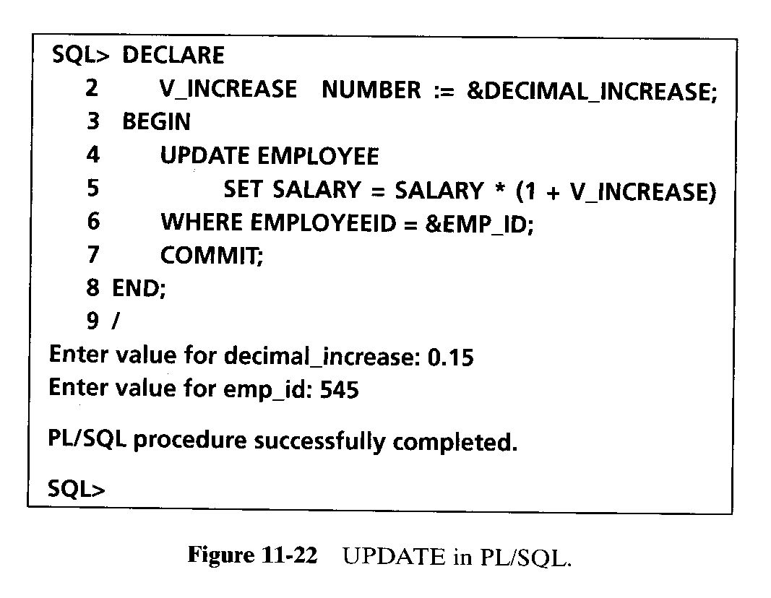
DATA MANIPULATION IN PL/SQL

Slide 42
Practice Exercises
Write a PL/SQL block to find out if a year is a leap year.
  A leap year is divisible by 4, but not divisible by 100, or it is divisible by 400.
  For example, 2000 and 2004 are leap years, but 1900 and 2001 are not leap years. (Hint: The function MOD (n, d) divides n by d and returns the integer remainder from the operation)‏
Write a PL/SQL block to print all odd numbers between 1 and 10 using a basic loop.
Using a FOR loop, print the values 10 to 1 in reverse order.
Create a table called ITEM with one column ItemNum with NUMBER type.
  Write a PL/SQL program to insert values of 1 to 5 for ItemNum.
Input a number with a substitution variable and then print its multiplication table using a WHILE loop.

Slide 43
Practice Exercises
Input a month number between 1 and 12 and a 4-digit year, and print number of days in that month.
  For February (month = 2), check for leap year to display number of days equal to 28 or 29.
Use a PL/SQL block to delete item number 4 from the ITEM table created in question 4.
Write a PL/SQL block to ask a user to input a valid employee Id.
  Retrieve employees name, qualification description, salary and commission.
  Print name, qualification and sum of salary and commission.

